Slide 1
CREDIT EDA CASE STUDY
BY:: Rohit Lal and Monica Fatwani

Slide 2
Application Data Frame

Slide 3
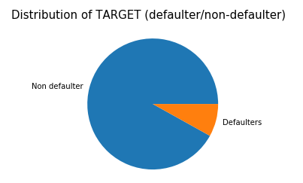
Target

Slide 4
Univariate Analysis – For Continuous Data Types:

Slide 5
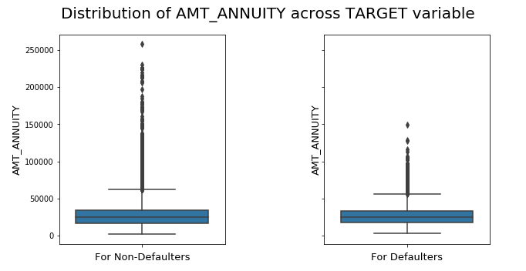
AMT_ANNUITY 1) No strong comparison found in AMT_ANNUITY with the TARGET variable 2) Non-defaulters have in generally loans with very high Annuity amounts (see, outliers in the above plot. Non-defaulters have very high magnitude of Outliers.) 3) This can be due to the High Annuity loans are provided only to trusted people which are Non-defaulters

Slide 6
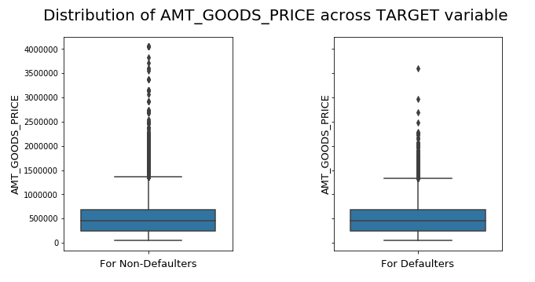
AMT_GOODS_PRICE 1) AMT_GOODS_PRICE column has quite high numbers of outliers. 2) Again, mean would not be an appropriate measure. We can use Median to estimate the missing values

Slide 7
Univariate Analysis – For Categorical Data types(Unordered):

Slide 8
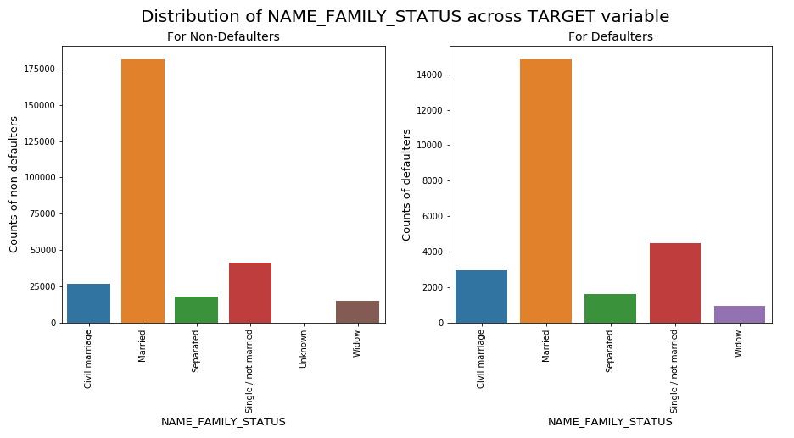
NAME_FAMILY_STATUS 1) Married people are at top in both defaulters and non-defaulters 2) Not-married ratio in defaulters is comparatively higher that that of non defaulted population.

Slide 9
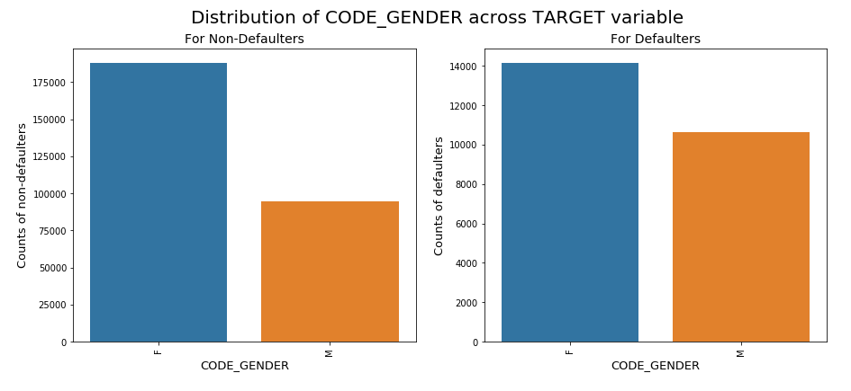
CODE_GENDER 1) Ratio of Female to Male in case of defaulters is comparatively less than that in case of Non-defaulters.

Slide 10
Univariate Analysis – For Categorical Data types(ordered):

Slide 11
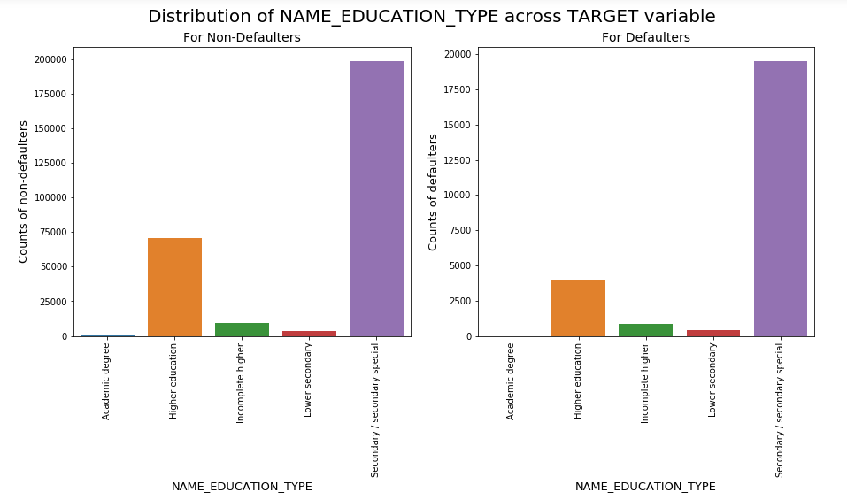
NAME_EDUCATION_TYPE 1) There is no strong relation between NAME_EDUCATION_TYPE & TARGET variable. 2) In general, Education Type 'Secondary/Secondary Special' is highest and Education Type 'Academic degree' is least for both TARGET categories.

Slide 12
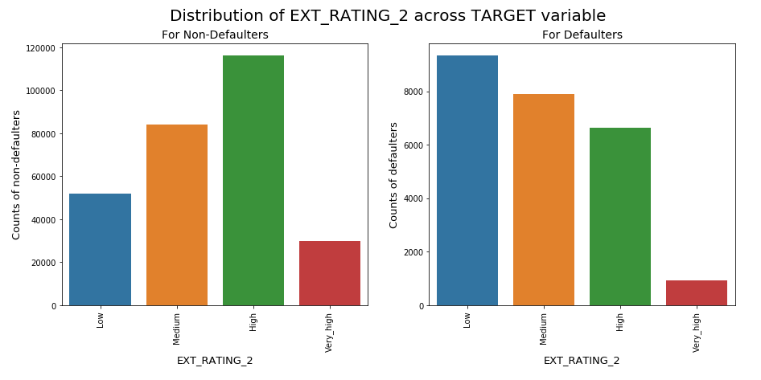
EXT_RATING_2 1) Low Ratings ratio in the Defaulters population is clearly higher as compared to the Non-defaulter population. 2) EXT_RATING_2 shows strong relationship with our target variable (i.e., defaulters/non-defaulters)

Slide 13
Correlation for Non-Defaulters

Slide 14
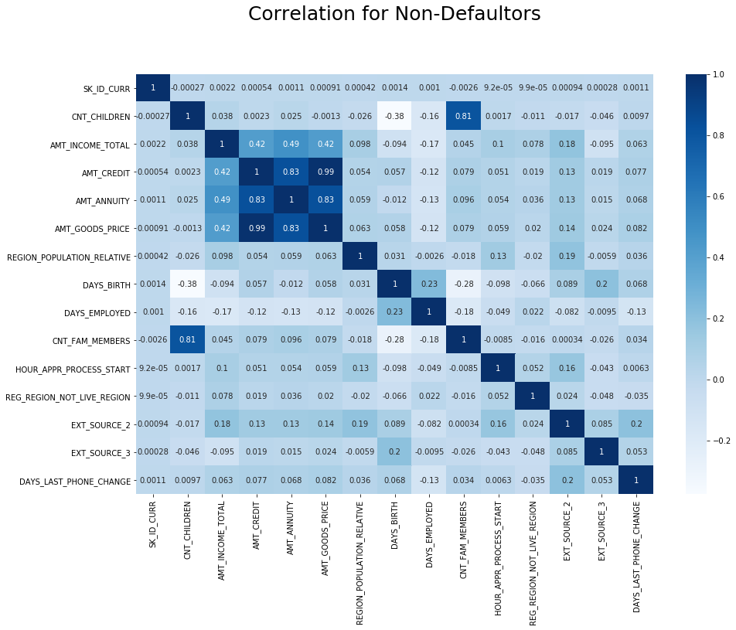

Slide 15
Correlation for Non-Defaulters(Type 0):
Total income and Credit amount are strongly related. It means wealthy people take generally higher credit amounts.
Credit Amount and Annuity are strong related. It is due the behaviour of business - For high credit amount loans, annuity will always be higher.
Children count and Family member count shows strong relation. Again, it is due the behaviour of the variable. More children constitutes to more family members.
Children and population density are also inversely related, means in densely populated region, clients have less children. This may due to space related constraints or some government body guidelines in dense regions.
Credit amount and population density are positively related. It means denser areas constitute good credit amount.

Slide 16
Correlation for Defaulters

Slide 17
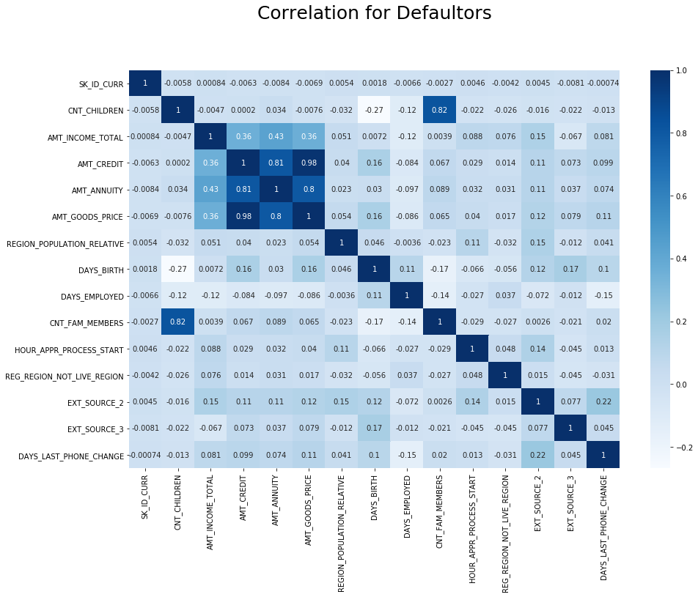

Slide 18
Correlation for Non-Defaulters(Type 1):
For Defaulters also, the prominent correlated variables are same as non-defaulters.
Total income and Credit amount are strongly related. It means wealthy people take generally higher credit amounts.
Credit Amount and Annuity are strong related. It is due the behaviour of business - For high credit amount loans, annuity will always be higher.
Children count and Family member count shows strong relation. Again, it is due the behaviour of the variable. More children constitutes to more family members.
Children and population density are also inversely related, means in densely populated region, clients have less children. This may due to space related constraints or some government body guidelines in dense regions.
Credit amount and population density are positively related. It means denser areas constitute good credit amount.

Slide 19
Bivariate (Continuous-Continuous)

Slide 20
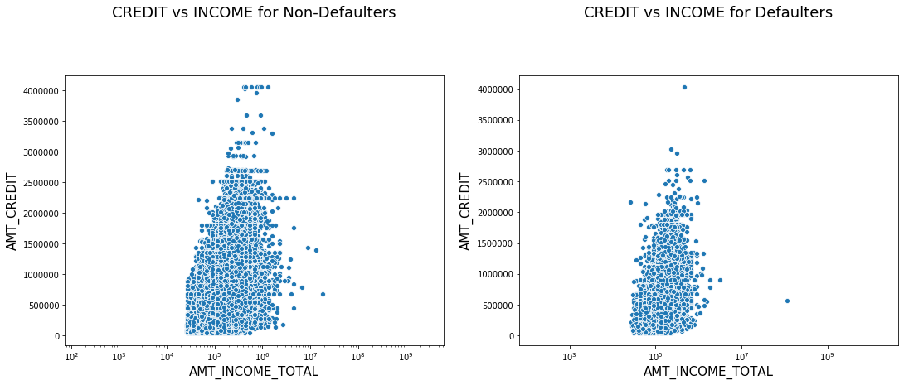
CREDIT v/s INCOME
Higher income candidates in general present in Non-defaulter population.
Log Scale for INCOME_TOTAL in above plots is chosen to take care of outlier points.

Slide 21
Bivariate(Continuous-Categorical)

Slide 22
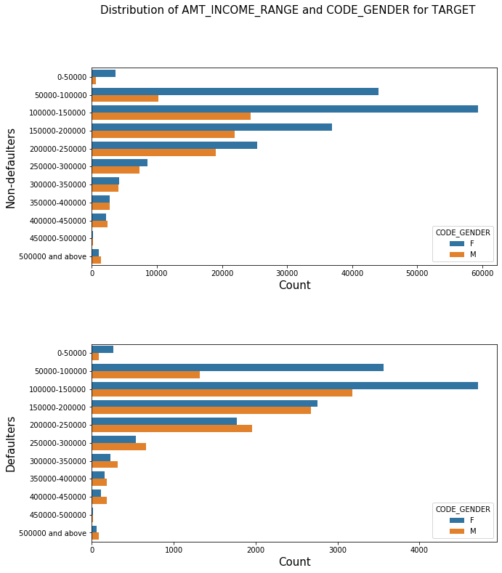
AMT_INCOME_RANGE v/s CODE_GENDER 1) Female counts are higher than male. 2) Income range from 50000 to 250000 is having more number of credits.

Slide 23
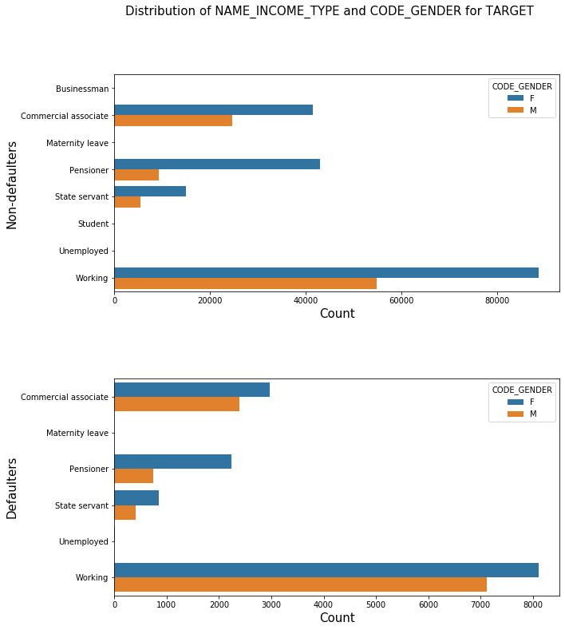
NAME_INCOME_TYPE v/s CODE_GENDER 1) For income type working, commercial associate, and State Servant, pensioner the number of credits are higher than others. 2) For this Females are having more number of credits than male. Less number of credits for income type student, Businessman and Unemployed.

Slide 24
Multivariate Analysis:

Slide 25
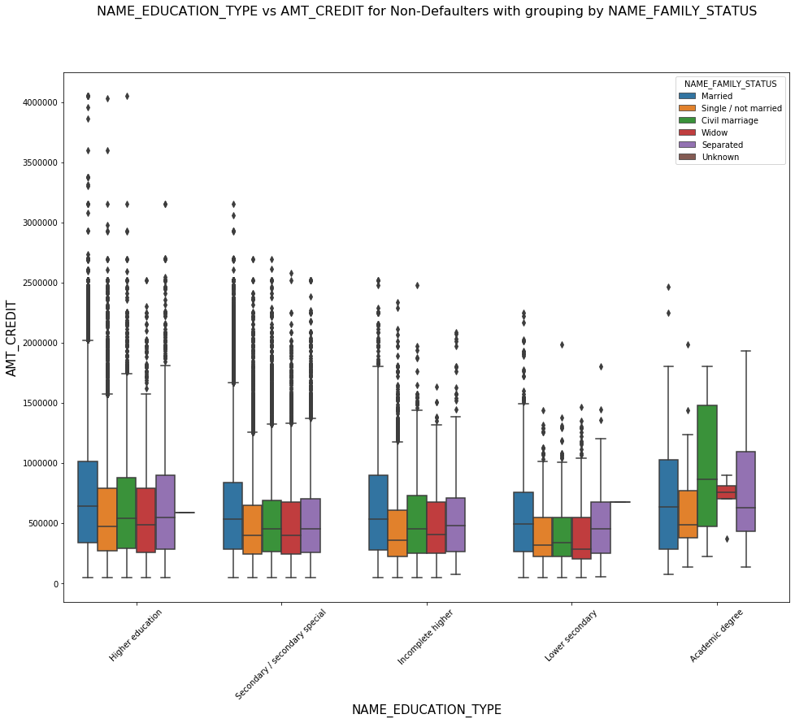
NAME_EDUCATION_TYPE v/s AMT_CREDIT v/s NAME_FAMILY_STATUS - Non Defaulters 1)In Academic degree category, AMT_CREDIT counts are much higher for Civil Marriage group. 2)In Academic degree category, AMT_CREDIT counts are minimum for Widow group.

Slide 26
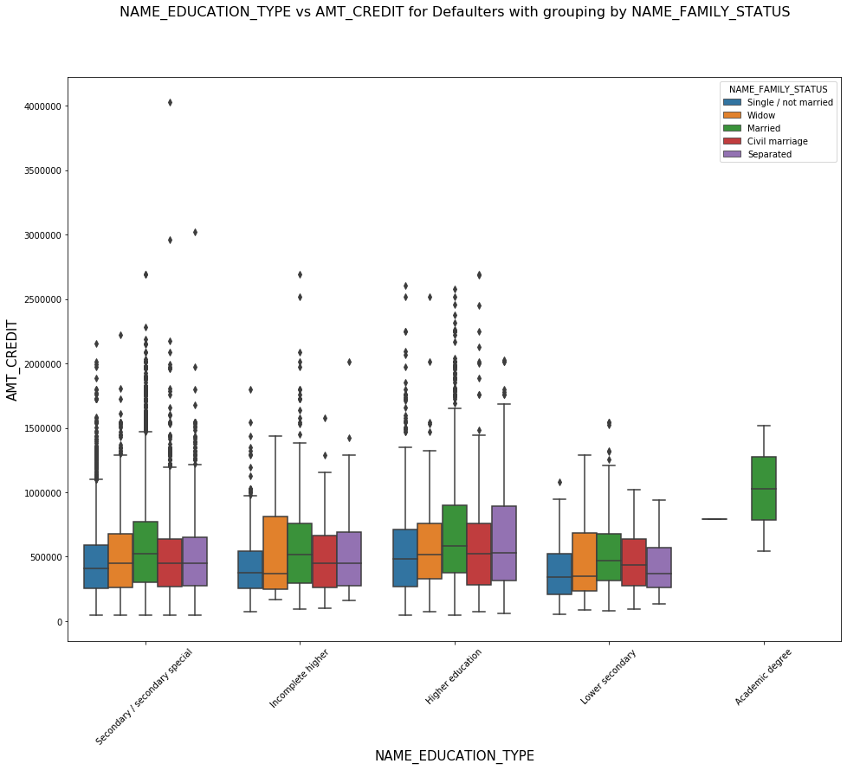
NAME_EDUCATION_TYPE v/s AMT_CREDIT v/s NAME_FAMILY_STATUS - Defaulters 1) In Academics category, only Married group has defaulters. 2) So, bank must prefer applicants with Academics degree and Non-married.

Slide 27
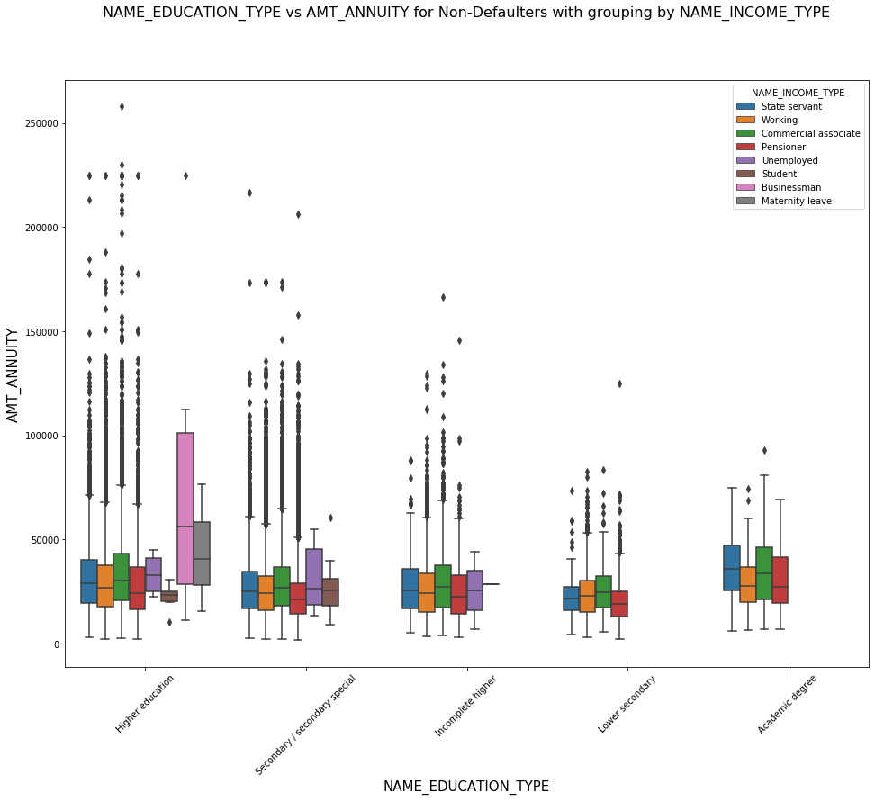
NAME_EDUCATION_TYPE v/s AMT_ANNUITY v/s NAME_INCOME_TYPE - Non-Defaulters 1) There are many applicants from Secondary/secondary special education type whose loan gets approved. 2) Higher Education:Businessman , Higher Education:Maternity leave and Higher Education:students should be targeted as they pay their loan on time as per the data

Slide 28
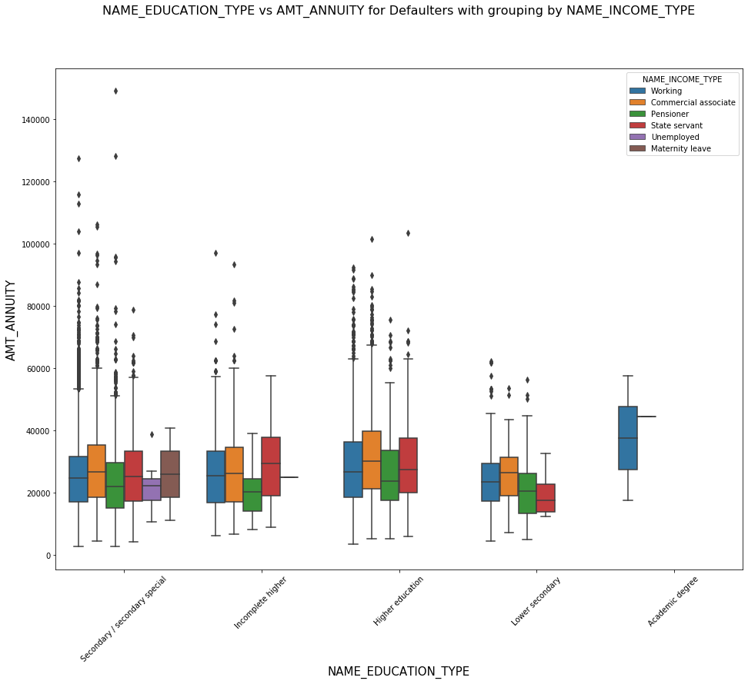
NAME_EDUCATION_TYPE v/s AMT_ANNUITY v/s NAME_INCOME_TYPE- Defaulters - Bank must focus on Academic degree Education Type non-working type as they are having higher number of successful payments on time.

Slide 29
Previous Application dataframe

Slide 30
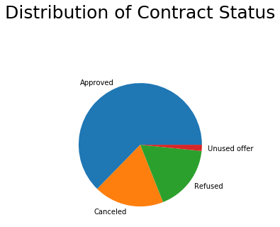
NAME_CONTRACT_STATUS

Slide 31
Univariate Analysis-
(Continuous Variables across Contract Status)

Slide 32
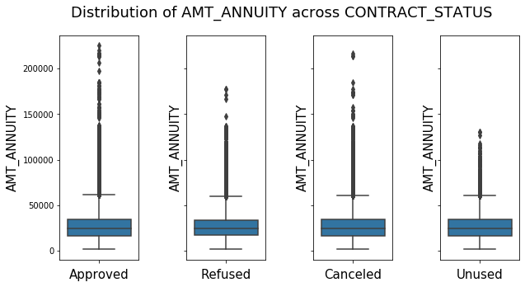
AMT_ANNUITY
No strong comparison visible in AMT_ANNUITY with the CONTRACT_STATUS variable
Refused & Unused have comparatively lesser Outliers count than the Approved & Canceled.

Slide 33
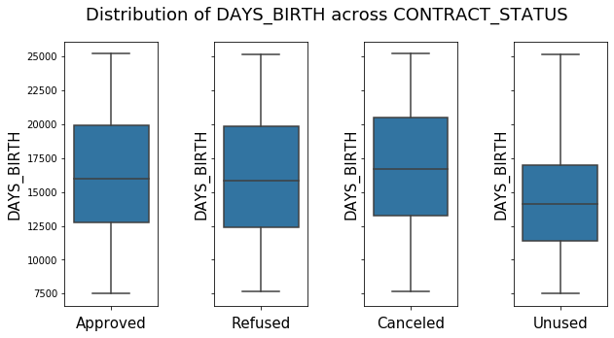
DAYS_BIRTH
Unused loans have in general lesser DAYS_BIRTH, i.e., younger clients are often constituting Unused loans.

Slide 34
Univariate Analysis-
(Categorical Variables across Contract Status)

Slide 35
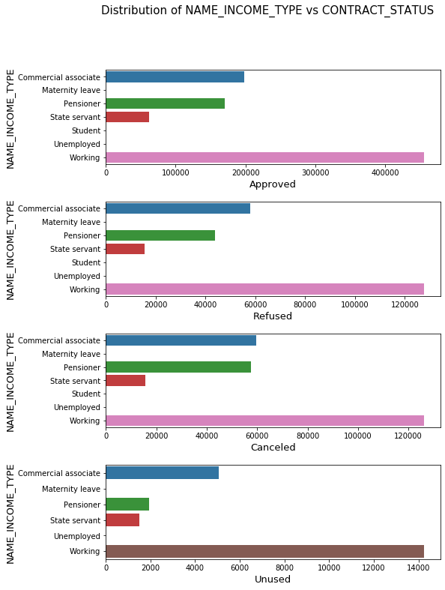
NAME_INCOME_TYPE In Canceled category, there is a huge difference in income type Pensioner & State servant

Slide 36
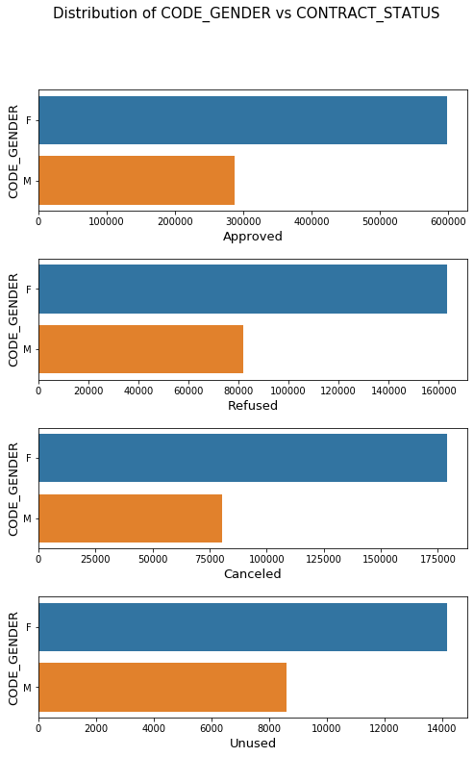
CODE_GENDER Males have considerably lesser counts in Canceled category as compared to Females.

Slide 37
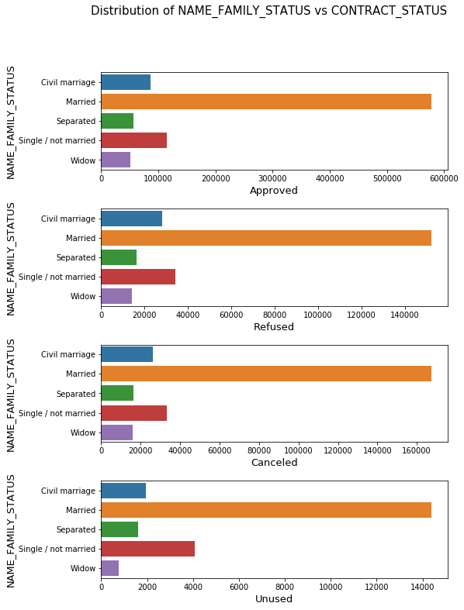
NAME_FAMILY_STATUS 1) Married people are at top in all CONTRACT_STATUS categories. 2) Single/Not-married ratio is comparatively higher in Unused category.

Slide 38
Bivariate Analysis

Slide 39
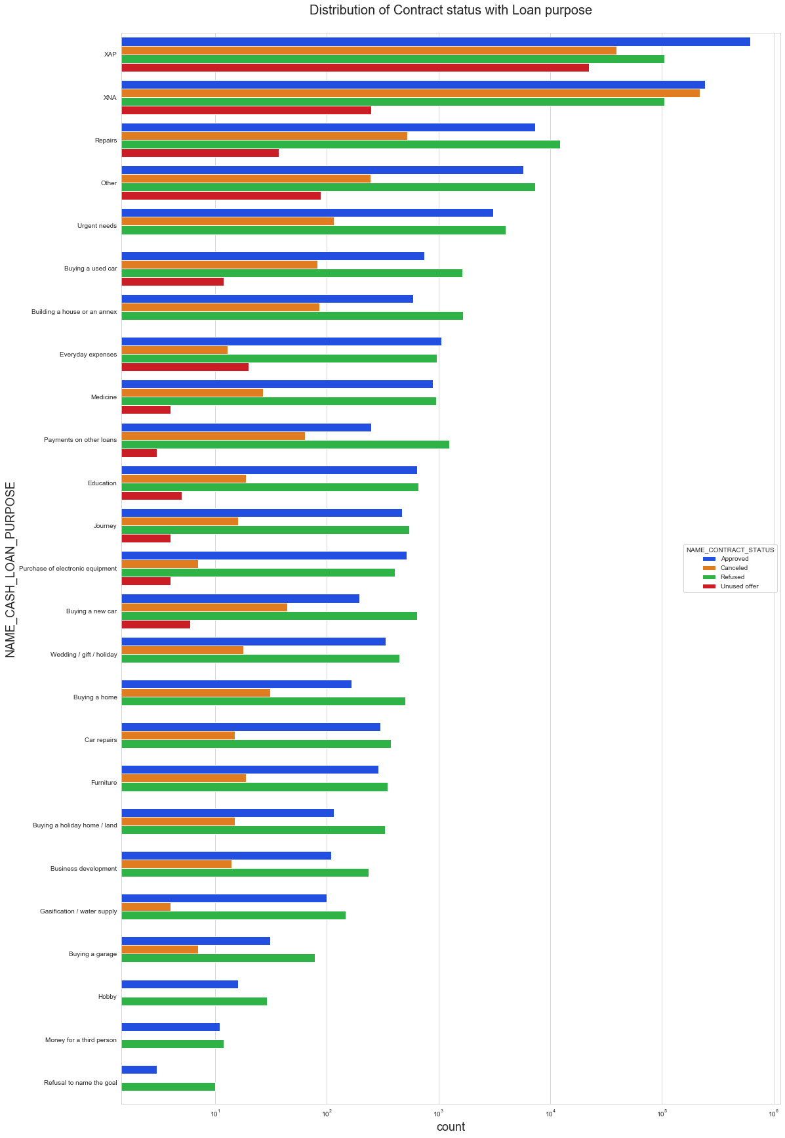
NAME_CASH_LOAN_PURPOSE v/s NAME_CONTRACT_STATUS

Slide 40
NAME_CASH_LOAN_PURPOSE v/s NAME_CONTRACT_STATUS
Repairs have most reject loans.
In Medicines we have almost equal number of approved & rejected loans.
In Education we have almost equal number of approved & rejected loans.
Paying other loans and buying a new car is having significant higher rejection than approves.

Slide 41
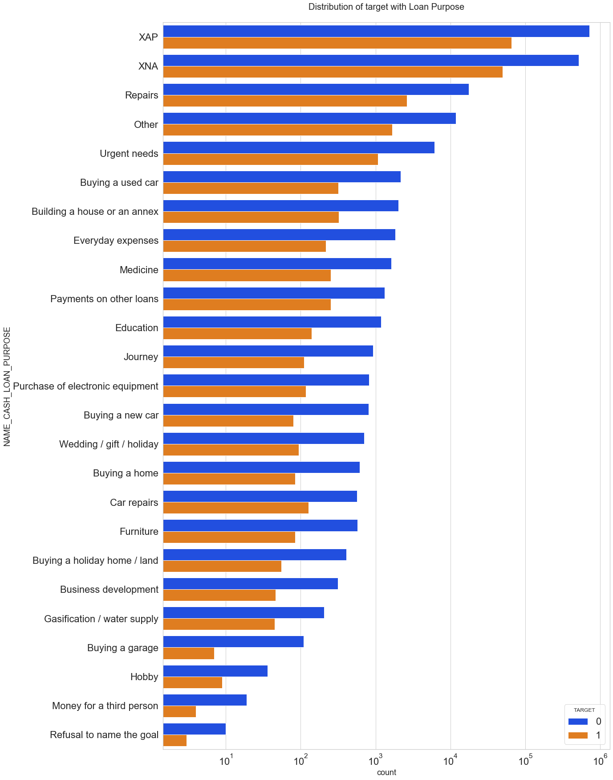
NAME_CASH_LOAN_PURPOSE v/s TARGET

Slide 42
NAME_CASH_LOAN_PURPOSE v/s TARGET
Repairs have considerably high count of defaulters.
Buying a garage has comparatively lesser defaulters and more non-defaulters.
Other loan purposes where non-defaulters count are significantly greater than the defaulter count are - Business Development, Buying a home, Buying a land, Buying a new car.

Slide 43
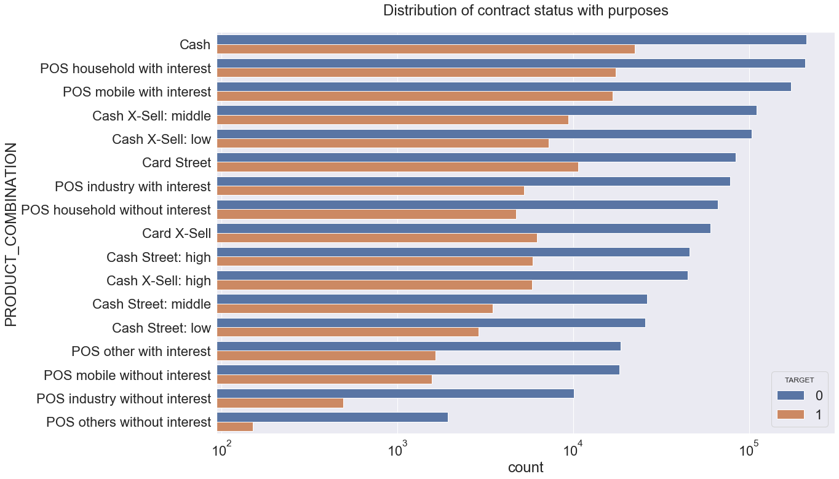
PRODUCT_COMBINATION v/s TARGET

Slide 44
PRODUCT_COMBINATION v/s TARGET
POS others without interest, POS industry without interest Product combinations should be targeted as their defaulter percentage is low compared to others.
Highest defaulter rate is for Product combination cash and highest non-defauters are also from Cash product combination. This may be because Cash combination count is high in our data set.

Slide 45
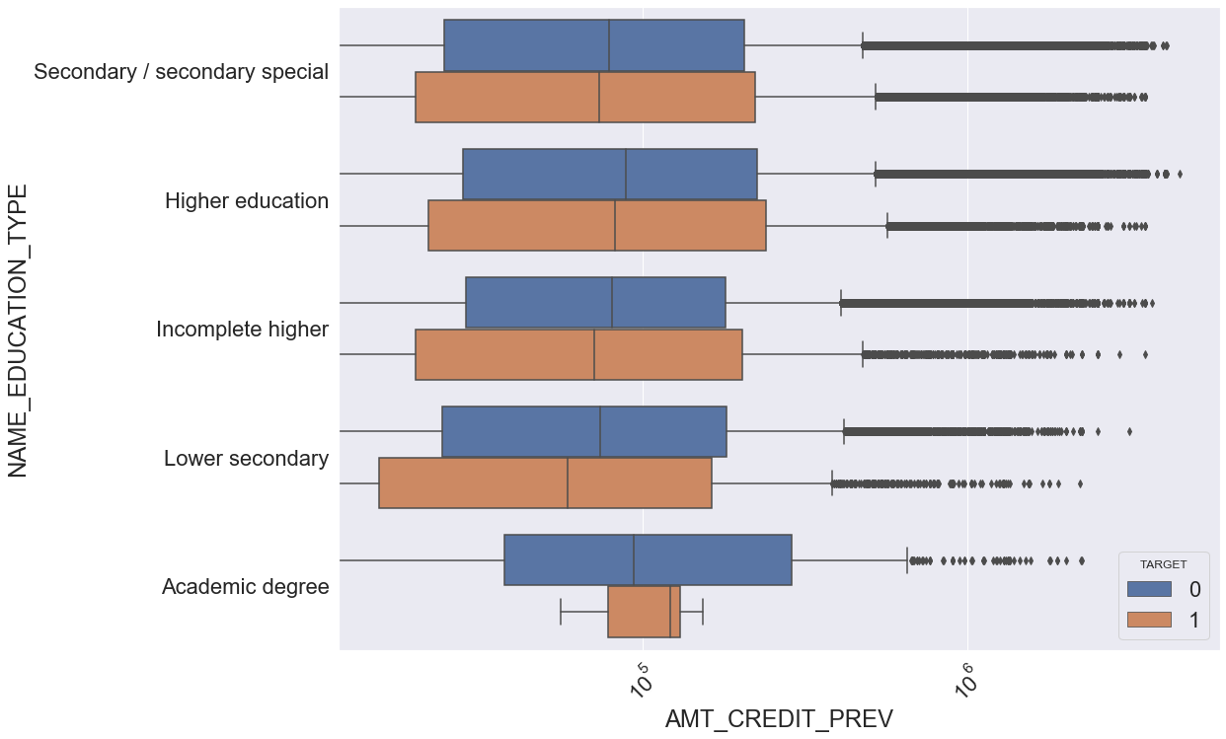
AMT_CREDIT_PREV v/s NAME_HOUSING_TYPE v/s TARGET

Slide 46
AMT_CREDIT_PREV v/s NAME_HOUSING_TYPE v/s TARGET
Office apartment, Co-op apartment have higher AMT_CREDIT for defaulters.
Municipal apartment have higher AMT_CREDIT for non-defaulters.
So, banks can focus on giving loans to House/apartment, Municipal Apartments, as they show positive results being non-defaulters.

Slide 47
CONCLUSION
Higher Education:Businessman, Higher Education:Maternity leave and Higher Education:students should be targeted as they pay their loan on time as per the data.
Bank must focus on Academic degree Education Type non-working type as they are having higher number of successful payments on time.
Loan purpose Repair is having higher number of unsuccessful payments on time.
Buying a garage, Business development, Buying land, Buying a new car and Education should be targeted as they are having minimum payment difficulties.
POS others without interest, POS industry without interest Product combinations should be targeted as their defaulter percentage is low compared to others.
Banks can focus on giving loans to House/apartment, Municipal Apartments, as they show positive results being non-defaulters.

Slide 48
Thanks for reading !

